Slide 1
Introductory Workshop
SPSS
CSU Stanislaus
February 21, 2014
Ed Nelson – CSU Fresno

Slide 2
Social Science Research and Instructional Council (SSRIC)
Discipline council for the social sciences made up of representatives from each campus in the CSU. There is a list of campus representatives on the website.
Promotes use of data analysis in research and teaching
Take a look at the SSRIC website.

Slide 3
The Council
Annual student research conference in April or May
Sponsors travel to ICPSR summer workshops in Ann Arbor, Michigan
Field Poll Faculty Fellowship proposals are due on April 15.

Slide 4
Social Science Data Bases
The SSRIC helps maintain and promote the use of the social science data bases in the CSU
Data bases include:
  Inter-university Consortium for Political and Social Research (ICPSR)
  The Field Institute
  The Roper Center for Public Opinion Research

Slide 5
Agenda for the Introductory
SPSS Workshop
Overview of SPSS
Creating you’re your own SPSS data file or opening a data file you got somewhere else
Transforming data
  Recode
  Select If
  Weight
Univariate analysis
  Frequencies
  Descriptives
  Explore

Slide 6
Getting More Information about the Screen Captures
The images in this PowerPoint are screen captures from SPSS and various web sites.
To see a description of the screen capture, right click on the image and then click on Format Picture. Click on Alt Text and a description of the image will appear.
To close the Alt Text box click on Close.

Slide 7
Overview of SPSS
SPSS is a statistical package for beginning, intermediate, and advanced data analysis.
Other statistical packages include SAS and Stata.
Online statistical packages that don’t require site licenses include SDA and R.

Slide 8
Text – SPSS for Windows
Version 19 A Basic Tutorial
Authors: Linda Fiddler (Bakersfield), Laura Hecht (Bakersfield), Ed Nelson (Fresno), Elizabeth Nelson (Fresno), Jim Ross (Bakersfield).
Available from McGraw-Hill Learning Solutions. Call 800-338-3987 to order. Request ISBN
0-07-804018-3.
Available on the web . The data set for this tutorial can be downloaded at this site.
An update for version 22 will be available soon on the SSRIC website.

Slide 9
SPSS Files and Extensions
Portable file -- .por
Data file -- .sav
Output file -- .spo
Syntax file -- .sps

Slide 10
Opening SPSS
Go to start and find SPSS for Windows.
Click on the version of SPSS that is on your server.
You’ll need to update your SPSS license every year (or your school technician will do it for you).

Slide 11
Creating Your Own SPSS Data File
(see ch. 2 in text)
Involves creating:
  Variable names
  Variable labels
  Value labels
  Missing values

Slide 12
Creating a Data File in SPSS
Questions
  Age
  Sex
  Political party identification
  Did you vote in the 2012 presidential election?
  Who did you vote for in the 2012 presidential election?

Slide 13
Basic Steps in Creating a Data File
Assign each variable a variable name and an extended variable label.
Each variable will have a set of values. Assign each value an extended value label.
If a variable has missing information, decide which values will be used as the missing values.

Slide 14
Variable Names
Traditionally variable names had to be 8 characters or less, start with a letter, and contain no embedded blanks.
Now they can be longer than 8 characters.
Names can contain some special characters, but not all such characters. So let’s avoid using special characters in names.

Slide 15
Variable Names Continued
Age is named AGE
Sex is named SEX
Political party identification is PARTY
Did you vote in the 2012 presidential election – VOTE12
Who did you vote for in the 2012 presidential election – PRES12

Slide 16
Values
SEX
  1 = male
  2 = female
  No missing information
AGE
  Enter age in years
  98 = 98 and older
  99 = no answer
PARTY
  1 = Democrat
  2 = Republican
  3 = Independent
  4 = other party
  5 = doesn’t identify with any party
  9 = no answer

Slide 17
Values Continued
VOTE12
  1 = yes
  2 = no
  3 = not registered to vote
  9 = no answer
PRES12
  1 = Obama
  2 = Romney
  3 = Other
  4 = did not vote
  9 = no answer

Slide 18
Entering the Information for a Data File
You already have SPSS open.
Click on File/New/Data.
You should see a blank data screen that looks like a spreadsheet.
At the bottom are two tabs called “Data View” and “Variable View”. Click on “Variable View”.

Slide 19
Defining the Variables
Enter the variable names in the “Names” columns in the order you want them.
Enter the variable labels in the “Label” column.
Enter the value labels in the “Values” column. To do this you will need to click in the appropriate cell and then click in the little gray box on the right.
Enter the missing values in the “Missing” column. To do this you will need to click in the appropriate cell and then click in the little gray box on the right.

Slide 20
Adding in the Data
Now that you have defined the variables, click on the tab at the bottom called “Data View” and enter the data into the appropriate cells. Make up the data so you have about ten cases entered.
Once you have entered the data, go back and check to make sure you didn’t make any data entry errors.
Congratulations!! – you created a SPSS data file. You could also enter the data using a spreadsheet like Excel.

Slide 21
Saving the Data File
Now you want to save your data file.
Click on “Save as”. The default is to save it as a SPSS data file with .sav as the extension.
Give it a file name and indicate where you want to save it on your hard drive or on your flashdrive.

Slide 22
Opening an Existing File
You Got Somewhere Else
Often you will want to open a data set that you got from someplace else such as:
  ICPSR
  Field Institute
  Roper Center
These files will usually be in the form of a:
  SPSS portable file (.por)
  SPSS data file (.sav)
  Raw data file with a SPSS syntax file (.sps)
  Raw data file without a syntax file

Slide 23
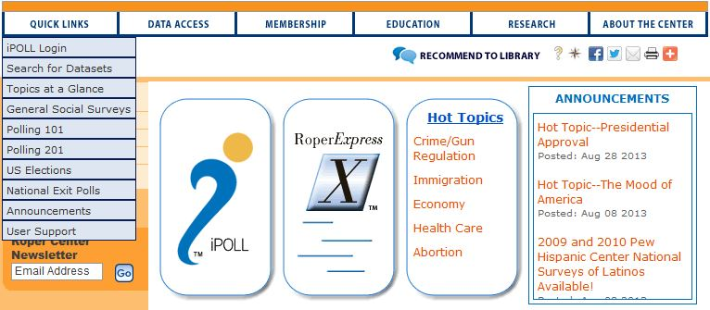
Roper Center for Public
Opinion Research

Slide 24
Creating your Own Account
The first thing you need to do is to create your own personal account at the Roper Center.
You’ll need this account to download data sets and to analyze data online.
These accounts are free.
To create your own account, you’ll need be on a computer on a CSU campus that has subscribed to the social science data bases.
Point your mouse at “Quick Links” in the upper left of the Roper home page. Click on “iPOLL Login” as shown on the next slide.
Click on “Sign In” at the top of the page.

Slide 25
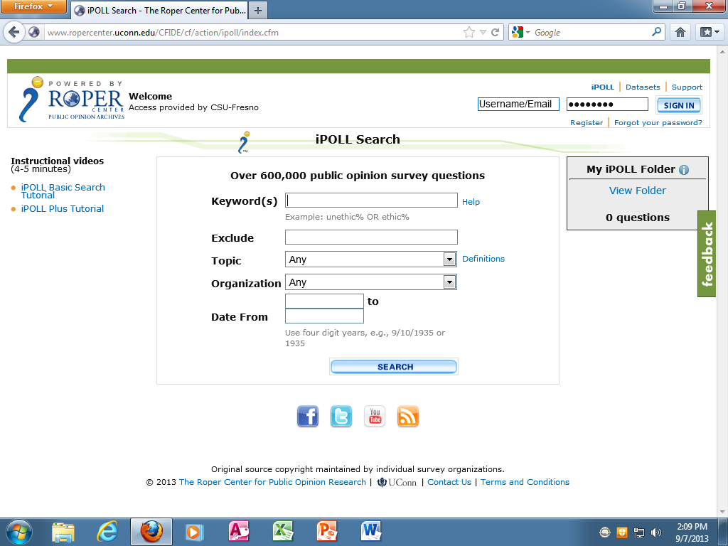
Creating your Own Account
Click on SIGN IN in the upper right.

Slide 26
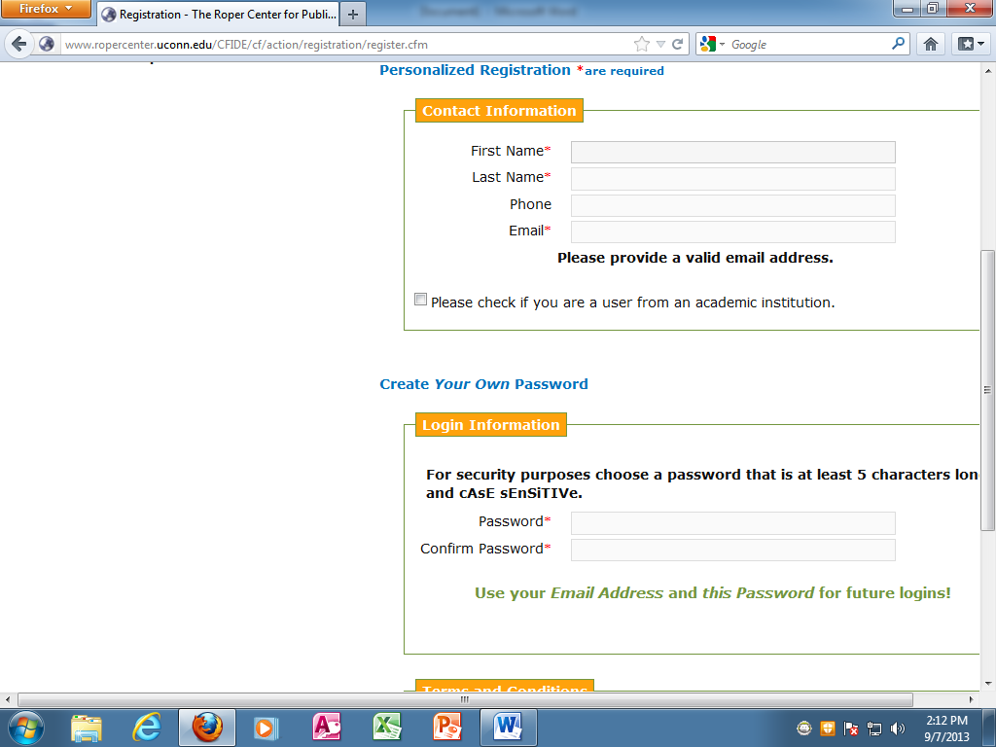
Fill Out From to Get Your Account

Slide 27
Logging onto your Account
When you want to use the Roper Center and it asks you to sign into your account, use your email address as your user name and the password you just created as your password.
Now that you have your account, you can access the Roper Center from off campus.
When you need to sign into your account, it will ask you to do so.

Slide 28
Downloading a File from Roper
Point your mouse at “Quick Links” and then click on “Search for Datasets”.
In the Search box enter “religion” and search for data from 2000 to 2014.
Look for the Gallup Poll – June Wave 1-2012. You’ll have to scroll down to the bottom of the first page of search results.

Slide 29
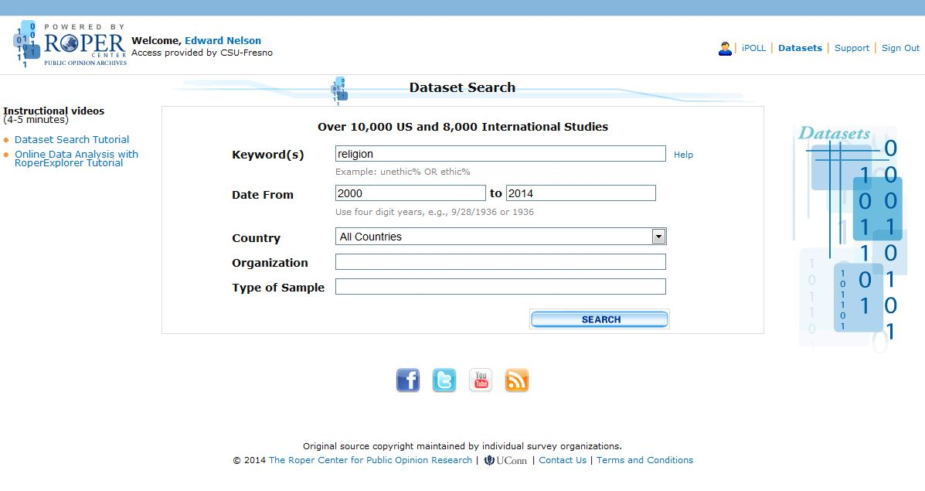
Searching for Datasets

Slide 30
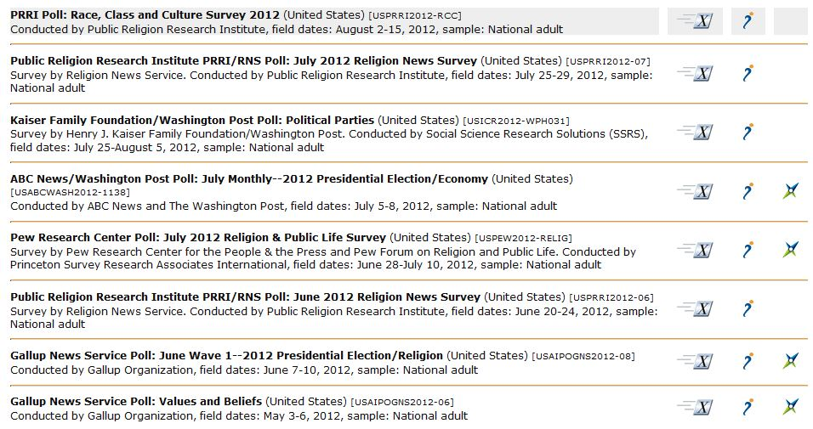
Search for Datasets Results
(your results may differ)

Slide 31
Downloading the Dataset
Click on the RoperExpress icon which looks like a slanted X.
You should see a page similar to the next slide.

Slide 32
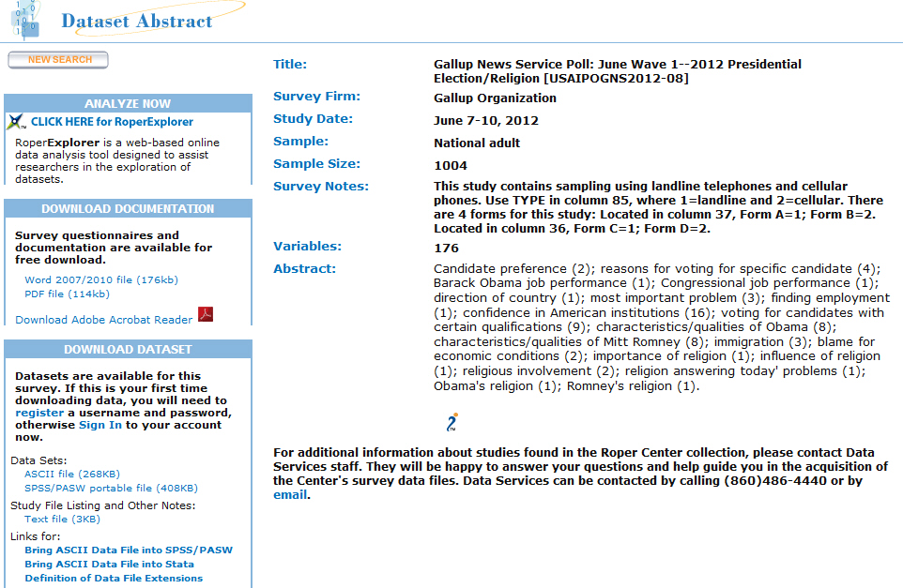
Dataset Abstract

Slide 33
Dataset Abstract Continued
In the dataset abstract you will see information about this dataset.
On the left you will see information about the documentation for this data set including the questionnaire. For this dataset you can download the documentation as a Word or PDF file.
You will also see information about downloading the dataset itself.

Slide 34
Downloading the SPSS Data File
You just created your account and chose a username and password and logged in. The next time you use Roper, you will have to log into your account with this username and password. You will be able to log into Roper from off campus.
This dataset can be downloaded as either an ASCII file or a SPSS file.
Let’s download the SPSS file by pointing to “SPSS/PASW portable file” and clicking on it. You should see the box on the next screen.

Slide 35
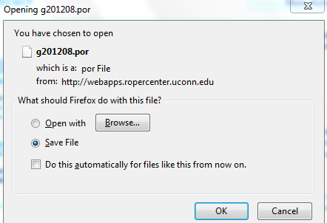
Downloading the Dataset Screen

Slide 36
Downloading the Dataset to
Your Computer
We want to save the file so select “Save File” and click OK.
The file will now be downloaded to wherever downloaded files are stored on your computer.
Go to your download folder and you should see a file with a .por extension. For this dataset it’s called g201208.por.
Notice that this a portable file.

Slide 37
Opening a Portable (.por) File
Click on the open yellow folder to open a new file.
Change file type to .por.
Browse to where the portable file you want to open is located and double click on that file.

Slide 38
Opening an SPSS Data (.sav) File
In SPSS, click on the open yellow folder just under File in the menu bar to open a new file.
Change file type to .sav.
Browse to where the data file you want to open is located and double click on that file.

Slide 39
Opening a Raw Data File with a SPSS Syntax File
Sometimes you will need to open a raw data file (ASCII or text) and there will be an accompanying SPSS syntax file.
You will need to modify the “File Handle” and “Save Outfile” commands. The next slide has instructions on how to do this and uses as an example a file downloaded from ICPSR.
You can ignore this until you need to download a data set that has a raw data file and a syntax file.
When this occurs, feel free to contact me for help.

Slide 40
Instructions for Modifying the “File Handle” and the “Save Outfile” commands
Start SPSS and open the syntax file (the one with the “.sps” extension).
Find the “FILE HANDLE” command and replace “data-filename” with the path to your data file (the one ending in “.txt”). For example, if you download ICPSR Study 4131 (ABC News Pennsylvania Poll, Sept. 2004) in a directory on your “C” drive called “Temp,” the path created will be "C:\Temp\5268001\ICPSR_04131\DS0001_ABC_News_Pennsylvania_Poll,_September_2004__\04131-0001-Data.txt." (This is admittedly pretty unwieldy, and it might be a good idea to move and rename the file before proceeding). The FILE HANDLE:
FILE HANDLE DATA / NAME="data-filename" LRECL=225 would become:
FILE HANDLE DATA / NAME="C:\Temp\5268001\ICPSR_04131\DS0001_ABC_News_Pennsylvania_Poll,_September_2004__\ 04131-0001-Data.txt " LRECL=225.
Find the “SAVE OUTFILE” command (probably the last one in the file), and replace “spss-filename.sav” with the name and path of the SPSS system file you wish to create. If the command is preceded by an asterisk, remove the asterisk. For example,
SAVE OUTFILE="spss-filename.sav“ would become:
SAVE OUTFILE="C:\Temp\5268001\ICPSR_04131\DS0001_ABC_News_Pennsylvania_Poll,_September_2004 __\04131-0001-Data.sav".
From the menu bar, click on “Run” and “All.”
If no "SAVE OUTFILE" command exits, create one from scratch. Note that all SPSS commands end with a period.

Slide 41
Opening a Raw Data File Without a SPSS Syntax File
If you don’t have a SPSS syntax file you will have to use the codebook that came with the data and create your own syntax file.
You may need help doing this. Feel free to contact me for help.

Slide 42
Choosing Options in SPSS
Click on “Edit” and “Options.”
General tab -- under “Variable Lists,” check “Display Names” and “Alphabetical.”
Now you will be able to view the variable names in alphabetical order.

Slide 43
Assigning Missing Values
We’re going to use some of the variables in this Gallup data set for the rest of this workshop.
Gallup didn’t assign any missing values so before we can do that we’ll need to assign some missing values.

Slide 44
Assign these Values as
Missing Values
D2 (age) – 0 is the code for DK/REF.
D3 (educational level) – 9 is the code for DK/REF.
D10 (ideology or conservative/liberal) – 6 is the code for DK and 7 is the code for REF.
Q9C (willingness to vote for a Black) – 3 is the code for DK and 4 is the code for REF.
Q9G (willingness to vote for a Mormon) – 3 is the code for DK and 4 is the code for REF.

Slide 45
What’s Next?
Now you know how to create a SPSS data file and how to open an existing SPSS portable or data file.
Next we’ll learn how to transform variables.

Slide 46
Transforming Data
(see ch. 3 in text)
We can transform variables by recoding which means to combine categories of an existing variable into fewer categories.
We can select particular cases and analyze only these cases
We can weight the data to correct for over sampling or under sampling certain types of respondents.
We can transform variables by creating new variables out of existing variables.

Slide 47
Recoding Variables
Recoding into different variables.
Recoding into the same variable.
We recommend recoding into different variables and not using the into same variable option.

Slide 48
Recoding into Different Variables
Click on “Transform” and then on “Recode” and then on “into different variables”.
Select the variable you want to recode.
Start by giving the new variable a new name and assigning a variable label to the new variable. Click on “Change”.

Slide 49
Recoding D2 (age) into D2R1
Recode age (D2) into four categories and give it the name of D2R1. This will stand for the first recode of D2.
Click on “Old and New Values”.
Use “Range” (fourth option down) to recode as follows. Remember to click on “Add” after entering each recode.
  18 to 29 = 1
  30 to 49 = 2
  50 to 69 = 3
  70 to 97 = 4 (note – 97 is the oldest person in the data base)

Slide 50
Recoding Options
When you click on “Old and New Values” there will be seven options.
For most recoding you will only have to use two of these options.
  The first option at the top allows you to recode a single value into a new value.
  The fourth option from the top allows you to recode a range of values from X to Y into a new value.

Slide 51
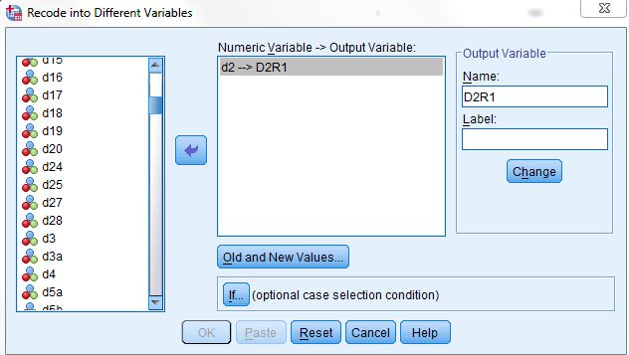
Recoding

Slide 52
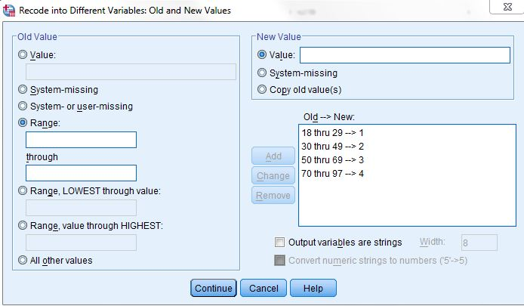
Recoding Continued

Slide 53
Assign Value Labels to the
Four Categories of D2R1
Go into “Variable View”.
Find the variable D2R1 (should be at the bottom of the list of variables).
Click in the “Values” column and then click on the small gray box.
Enter the value labels.
Click on OK.

Slide 54
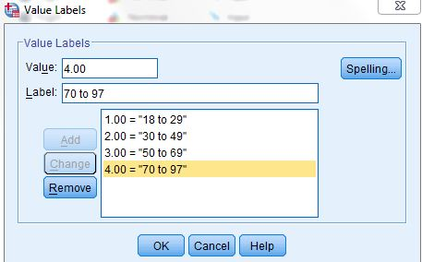
Adding Value Labels

Slide 55
Exercise for Recoding
Let’s recode age in a different way.
Instead of recoding age into four categories let’s recode age into six categories. Call this new variable D2R2.
  1 = under 30
  2 = 30 to 39
  3 = 40 to 49
  4 = 50 to 59
  5 = 60 to 69
  6 = 70 and over
Add the value labels

Slide 56
Using Select Cases to Select Specific Cases for Analysis
Let’s select only the males for further analysis.
Click on “Data” and then on “Select Cases”.
Select “If condition is satisfied” and then on the “If” button below it.
Select the variable sex (D1) and move it into the box on the right.
In this box, enter the expression “d1 = 1”.
Click on “Continue” and on OK.

Slide 57
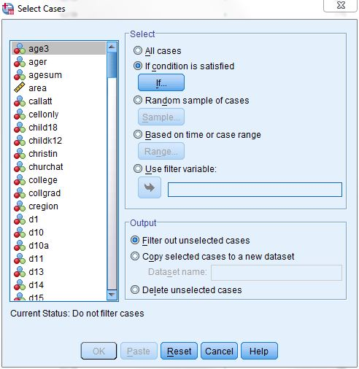
Selecting Cases

Slide 58
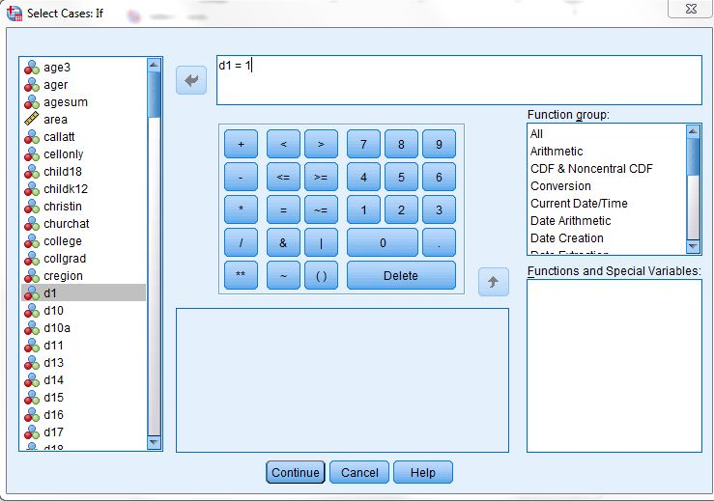
Selecting Cases If Condition is Satisfied

Slide 59
Using Select Cases Continued
Now lets select Males who are under 35 years age old.
Enter the expression “d1 = 1” as you did before.
Use & for and. Enter “d2 < 35” so the expression reads “d1 = 1 & d2 < 35”.
Click on OK.

Slide 60
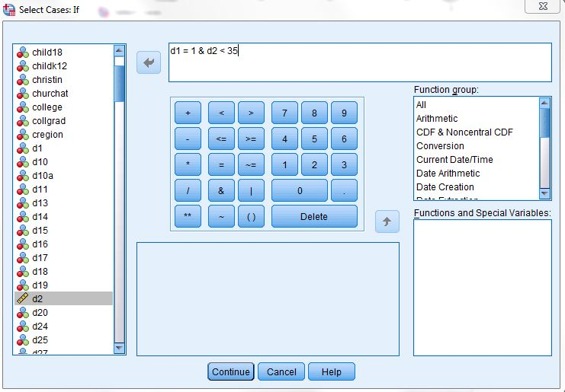
Another Example of Selecting Cases

Slide 61
Exercise for Select If
Select all males (1 on the variable D1) and do a frequency distribution for the variable D10 (political ideology – conservative/liberal).
Now select all females (2 on the variable D1) and run a frequency distribution for D10.
Are males or females more likely to be conservative? There’s an easier way to do this (crosstabs) that we will talk about later.

Slide 62
Important Note on Using
Select Cases
When you are finished using “Select Cases” and want to revert to using all the cases be sure to click on Data/Select Cases and select “All cases”. Then click on OK.
If you don’t do this, you will continue to use only those cases you last selected

Slide 63
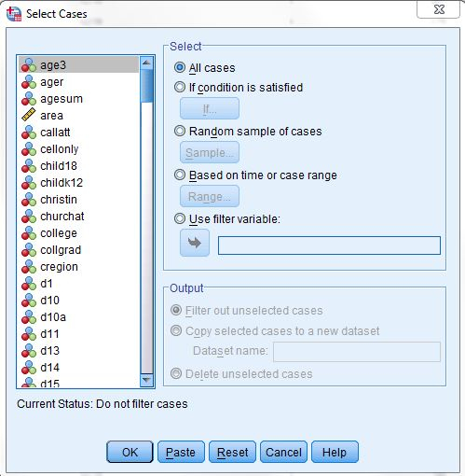
Selecting All Cases

Slide 64
Weighting Cases
Click on “Data” on the menu bar.
Click on “Weight Cases”.
Select “Weight cases by”.
In the list of variables on the left, select the weight variable (WTFCTR).
Click on the arrow that points right to move this variable into the “Weight cases by” box.
Click on OK.

Slide 65
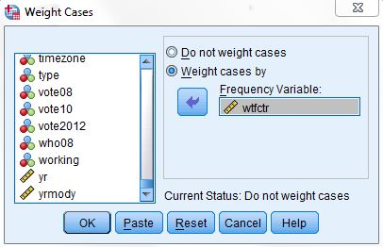
Weighting Cases Box

Slide 66
Univariate Analysis
Now that we know how to open existing files and transform variables, we’re ready to begin analyzing data.
Univariate analysis refers to analyzing variables one-at-a-time.

Slide 67
Types of Univariate
Analysis Procedures
(see ch. 4 in text)
Frequencies
Descriptives
Explore

Slide 68
Frequencies
Go to Analyze/Descriptive Statistics/Frequencies.
Select D2, D2R1, Q9C and Q9G and move them into the large box on the right by clicking on the arrow that points to the right.
Click on OK.

Slide 69
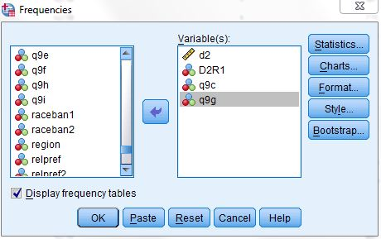
Frequencies Box

Slide 70
Bar Charts
Bar charts – click on Analyze/Descriptive Statistics/Frequencies.
Click on “Charts”.
Select “Bar Charts” and click on “Continue” and then on OK.

Slide 71
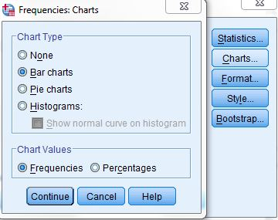
Frequencies Chart Box –
Select Bar Charts

Slide 72
Histograms
Click on click on Analyze/Descriptive Statistics/Frequencies
Click on “Charts”
Select “Histograms” and click on “Continue” and then on OK
Which do you think is the most appropriate chart (bar chart or histogram) for Q9C, Q9G, D2 and for D2R1?

Slide 73
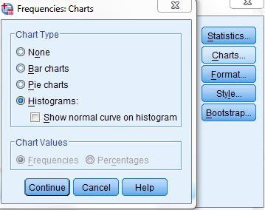
Frequencies Chart Box –
Select Histograms

Slide 74
Statistics
Click on Analyze/Descriptive Statistics/Frequencies.
Click on “Statistics”.
Select the statistics you want and click on “Continue” and then on OK.

Slide 75
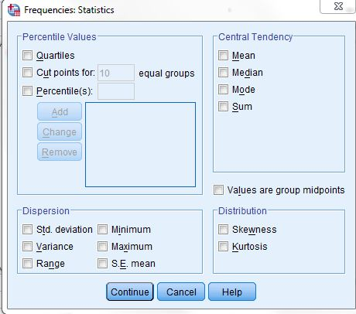
Statistics Box

Slide 76
Exercise for Frequencies
Run a frequency distribution for D3.
Get a bar chart for D3.
What does this tell you about the distribution of education for this sample?

Slide 77
Descriptives
Click on Analyze/Descriptive Statistics/Descriptives.
Select D2.
Click on “Options” and select the statistics you want and then click on “Continue” and OK.

Slide 78
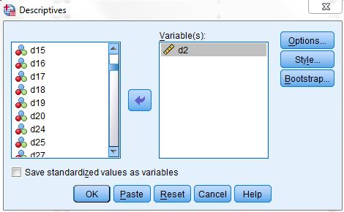
Descriptives Box

Slide 79
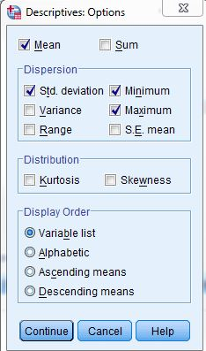
Descriptives Options Box

Slide 80
Exercise for Descriptives
Use Descriptives to compute the following statistics for D2
  Mean
  Standard deviation
  Variance
  Skewness
  Kurtosis

Slide 81
Explore
Click on Analyze/Descriptive Statistics/Explore.
Select D2 and put it in the “Dependent List”.
In the Display box on the lower left, click on “Both”.
Click on OK.

Slide 82
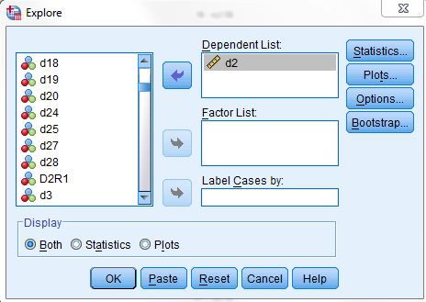
Explore Box

Slide 83
Selecting Statistics for Explore
Click on Analyze/Descriptive Statistics/Explore.
Click on “Statistics.” “Descriptives” is the default. Click also “outliers” and “percentiles.”
Click on “Continue” and then OK.

Slide 84
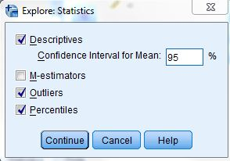
Explore -- Statistics

Slide 85
Copying Tables from SPSS into Word
Select the table in SPSS by clicking on it.
Click on Edit and then on Copy Special and make sure that Enhanced Metafile is selected.
Go to your report in Word and click on Edit/Paste Special/Enhanced Metafile/OK.

Slide 86
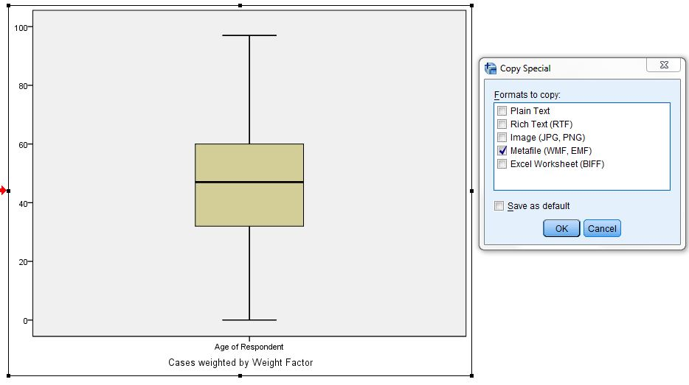
Copying Tables

Slide 87
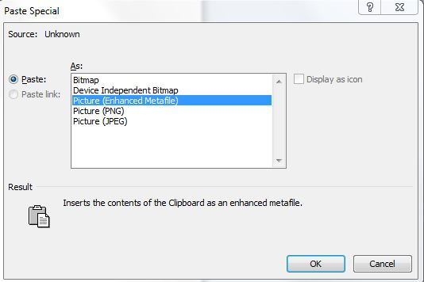
Paste Special

Slide 88
Where to go for more information
For a quick look at how to access the data bases, go to the SSRIC Website and click on Data in the menu bar.
For short videos on the data bases, go to the SSRIC website and click on Participate and then on Workshops. You’ll se YouTube videos under online workshop materials
For more detailed information, go to the SSRIC website and click on Participate and then on Workshops. You’ll see PowerPoints under online workshop materials

Slide 89
Intermediate Workshop for SPSS
In the intermediate workshop we’ll look at different types of statistical analysis you can do in SPSS
  Cross tabulations (bivariate) (ch. 5)
  Comparing means (ch. 6)
  Correlation and regression (ch. 7)
  Multivariate analysis (ch. 8)
    Cross tabulations
    Multiple regression
  Presenting your data – charts and tables (ch. 9)

Slide 90
How to contact me
Ed Nelson
CSU Fresno
ednelson@csufresno.edu
559-978-9391 (cell)

